Slide 1

GREY BOX TESTING
Submitted By
Nishanthini V

Slide 2
what is grey Box Testing?
A grey Box Testing is a combination of Black Box testing and White Box testing.
A grey box tester adopts the code-designated strategy of white box testing and unions it with the different methodologies of discovery testing like functional testing and regression testing. The tester assesses both the software’s internal workings and its user interface.
Grey Box test partially knows the internal structure and algorithms of designing the test cases.
Need overall and detailed description of document of the application.

Slide 3
Generic Steps to perform Grey box Testing
First, select and identify inputs from BlackBox and WhiteBox testing inputs.
Second, Identify expected outputs from these selected inputs.
Third, identify all the major paths to traverse through during the testing period.
The fourth task is to identify sub-functions which are the part of main functions to perform deep level testing.
The fifth task is to identify inputs for subfunctions.
The sixth task is to identify expected outputs for subfunctions.
The seventh task includes executing a test case for Subfunctions.
The eighth task includes verification of the correctness of result.

Slide 4
Techniques
There are mainly four different ways to perform gray box testing
Matrix testing
This testing strategy includes characterizing every one of the factors that exist in their projects.
Developers define each of the variables has an inherent technical and business risk and can be used with varied frequency during its life cycle.
Regression testing
It requires performing repeated gray box tests to confirm that recently made and tried programming actually functions as wanted after each renewal.
Some testing that make new changes that will cause new bug/defect/error

Slide 5
Techniques
Orthogonal array testing
This testing is a coordinated, measurable strategy for performing tests.
This procedure takes into consideration most extreme code inclusion while utilizing negligible experiments, particularly when testing complex applications and subset of all possible combination.
Pattern testing
To perform the testing,previous defects are analyzed. And it determine the causse of the failure by looking into the code.
This help test cases designed as they are proactive in finding other failures before hitting production..

Slide 6
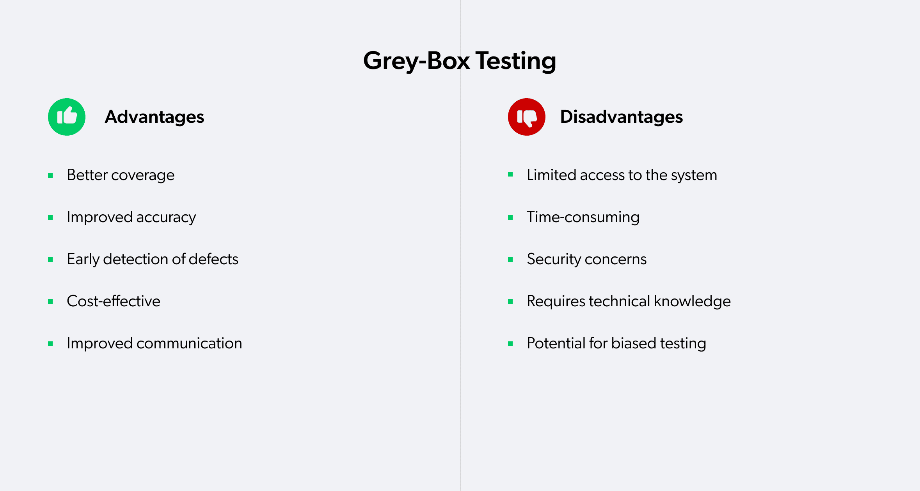
Advantages and Disadvantages

